Slide 1



Jaypee University of Information Technology
Department of Computer Science and Engineering and Information Technology
Major Project - I (18B19CI791) | AY 2025-26
Mid-Term Evaluation | Sept 29 – Oct 03, 2025.
AI-Powered Career Growth and Productivity Platform
Group No.: 63
Team Member (s)
Supervisor Name: Mr. Aayush Sharma
Designation: Assistant Professor
Priyansh Lunawat (221030169)
Naman Mittal (221030259)
Udit Sharma(221030199)
Ashish Agarwal (221030420)

Slide 2
Outline
Introduction
Problem Statement
Objectives
Literature Review
Project Design
Tools, Technologies and Languages
Dataset
Key Learnings
Work Plan till End-Term Evaluation
Project Plan
Work Contribution and Attendance
Supervisor Interactions
References

Slide 3
Introduction
Today’s job market is highly competitive, requiring more than just polished resumes.
Employers expect strong communication, problem-solving, and technical expertise.
Traditional methods (resume templates, generic guides, offline tests) are time-consuming and lack personalization.
AI and NLP enable customized, intelligent, and adaptive career preparation solutions.
This project integrates career guidance with skill evaluation using AI.
Ensures users are interview-ready and technically competent.

Slide 4
Problem Statement
Traditional career platforms provide static resumes and templates that are not optimized for Applicant Tracking Systems (ATS).
Existing systems treat resume building, interview preparation, and coding assessments as separate workflows, causing inefficiency.
Lack of personalized guidance such as future job role prediction based on a candidate’s profile.
Coding exam platforms often fail to provide secure environments, plagiarism checks, and detailed analytics.
Minimal feedback or learning roadmaps are given to users for continuous career growth.
Job seekers face challenges in aligning their skills with industry requirements due to absence of integrated, AI-powered solutions.

Slide 5
Objectives
The project is developed with the following objectives:
To generate AI-optimized resumes and cover letters tailored to specific job roles.
To predict suitable future job roles based on resume data.
To simulate interview training using AI-driven Q&A sessions with feedback.
To conduct personalized coding assessments aligned with user skills.
To provide analytics and learning roadmaps for career growth.

Slide 6
Literature Review
S. No. | Author & Paper Title [Citation] | Journal/ Conference (Year) | Tools/ Techniques/ Dataset | Key Findings/ Results | Limitations/ Gaps Identified
1. | Nguyen, T. T. H. et al. – SimInterview: Transforming Business Education through LLM-Based Simulated Multilingual Interview Training System | arXiv (2025) | LLMs (OpenAI o3, Llama 4, Gemma 3), Whisper STT, GPT-SoVITS, Ditto avatar, ChromaDB vector DB, retrieval-augmented generation | System aligns interview content with resume, supports multilingual interviews, high user satisfaction, helps users better prepare for real interviews | Focused on improving learner confidence but lacks comprehensive employability analytics.
2. | Koshti, H. et al. – AI-Powered Interview Preparation System: Integrating Resume Analysis, HR Simulation, and Technical Skill Assessment | Journal of Engineering Research & Reports (2025) | CNN for emotion detection, NLP for resume analysis, Speech Recognition, integration with ATS & HR simulator | Improved candidate preparation efficiency, more objective evaluation, real-time feedback & insights vs traditional methods | The system provides candidate alignment but lacks future career trajectory guidance
3. | Gayathri Devi M. et al. – AI Friendly Resume | IJSREM (2024) | AI / NLP for keyword extraction, semantic matching, formatting for ATS compatibility | Significant increase in resume shortlisting rates compared to traditional formats | Focuses only on resume optimization for ATS, ignoring other stages of the recruitment process.
4. | Kumari & Kumar AI-Based Mock Interview Platform (“AI-Based Mock Interview Platform” | IRJMETS (2025) | Smart resume parsing, emotion detection, dynamic question generation, scoring across emotional/ verbal / cognitive domains | Personalized interview practice, real-time feedback, detailed performance breakdowns | System efficiency depends on resume data quality; poor data reduces accuracy.

Slide 7
Literature Review (cont…)
S. No. | Author & Paper Title [Citation] | Journal/ Conference (Year) | Tools/ Techniques/ Dataset | Key Findings/ Results | Limitations/ Gaps Identified
5. | Soumya S., Mr. Musheer Ahmed. AI Powered Career Path Recommender. | Zhuzao/Foundry (2025) | ML, Deep Learning, Reinforcement Learning, NLP, Hybrid Recommendation, LLM. | Personalized career suggestions; resume & cover letter automation; quizzes & performance feedback; improved career match accuracy and user confidence. | Cold-start problem for new users; relies on input data quality; needs better real-time data integration and
6. | Revolutionizing Nearby Accommodation: An in-depth Analysis of React.js, Node.js, MongoDB, and Express.js Integration for Website Development Chirag Yadav Rahul Dhakad Afroj Mihir Panchal Er. Bhupinder Kaur | International Conference on Innovative Computing & Communication (ICICC 2024) | React.js, Node.js, Express.js, MongoDB (no external dataset, application-based testing) | The MERN stack integration significantly improved website scalability, responsiveness, and user experience for nearby accommodation systems. | Limited to small-to-medium scale testing, lacking performance validation on real-world large datasets and high traffic loads.
7. | Constructing a Study Buddy Using MERN (MongoDB, Express.js, React, Node.js) Stack Technologies Chamalla Sravani,Pudi Kumar Sanapala Priya | July 2024 | MongoDB, Express.js, React.js, Node.js (custom student interaction dataset) | The MERN-powered study buddy facilitated collaborative learning and improved engagement among students. | The system lacked advanced personalization and was tested on a limited user base.
8. | Mern(Mongodb , Express-Js, React-Js, Node-Js) Stack Web-Based Themefied Education Platform For Placement Preparation Varsha Sahni ,Atharva Chopde | Educational Administration Theory and Practice journal (2024) | MongoDB, Express.js, React.js, Node.js | The MERN-based education platform provided an interactive, themefied environment that enhanced placement preparation efficiency. | System scalability and adaptability to diverse curricula and larger student groups were not extensively validated.
Major Project – I (18B19CI791) Mid-Term Evaluation | Department of CSE & IT | AY 2025-26. _{7.}

Slide 8
Literature Review (cont…)
S. No. | Author & Paper Title [Citation] | Journal/ Conference (Year) | Tools/ Techniques/ Dataset | Key Findings/ Results | Limitations/ Gaps Identified
9. | AI-Powered Recruitment: Transforming Talent Acquisition in the Digital Age Devashish Pandey | February 2025 | AI/ML models, NLP libraries (e.g., spaCy, TensorFlow), recruitment datasets/resume databases | The AI-powered system streamlined candidate shortlisting and reduced hiring time significantly. | Potential algorithmic bias and dependence on dataset quality limited fairness and generalizability.
10. | Resume Optimization Model Using Machine Learning Techniques Chinwe Gilean Onukwugha,Christopher Ofoegbu,Obinna Banner Aliche,Chidi Ukamaka Betrand | October 2024 International Journal of Intelligent Information Systems | Machine Learning algorithms (e.g., Logistic Regression, SVM), NLP libraries (NLTK, scikit-learn), resume datasets | The model successfully optimized resumes by highlighting skills and keywords aligned with job descriptions. | Limited generalization across industries due to dataset bias and varying job role requirements.
11. | Rahman et al– Career Path Recommendation System | IERJ (2022) | Automated code evaluation, suggestion modules | Evaluates submitted code and provides improvement suggestions | Does not include resume optimization, interview preparation, or coding assessments.
12. | Priskilla Angel Rani J, et al. — Personalized Career Roadmap Generation | IJNRD, 2025 | Python, Streamlit, SQL, NLTK, SpaCy, scikit-learn, job APIs, resumes | Resume quality ↑ 45%, Job match accuracy 85%, Better user engagement | Small sample, short-term study, external factors not considered
Major Project – I (18B19CI791) Mid-Term Evaluation | Department of CSE & IT | AY 2025-26. _{8.}

Slide 9
Literature Review (cont…)
S. No. | Author & Paper Title [Citation] | Journal/ Conference (Year) | Tools/ Techniques/ Dataset | Key Findings/ Results | Limitations/ Gaps Identified
13. | M. Venkateswar Reddy et al. – Professional Resume Generator | Research Proposal, ResearchGate (March 2025) | Full-stack,ML,Scikit-learn NLP for keyword analysis; | 35% better resume scores, 87% ATS pass rate, 88% user satisfaction with strong feedback engagement. | Small training dataset, limited accuracy, no resume storage, lacks broader career tools.
14. | Dr. Mahesh B. Gunjal et al. – A Review Paper on Resume Parser Using AI | IJIRT, Vol. 11, Issue 8 (Jan 2025) | NLP, NER, Regex, Layout-aware parsing, ML (Tf-Idf, cosine similarity), CNN, Generative AI | AI-based resume parsers improve efficiency, accuracy, and job-matching; layout-aware and hybrid methods enhance extraction from varied formats. | Ethical bias issues, reliance on limited datasets, lack of HR expert validation, and scalability challenges in real-world recruitment.
15. | R.V.K. Bevara et al. – Resume2Vec: Advancing Recruitment with Transformer-Based Embeddings for Resume Ranking | Electronics (MDPI), Vol. 14, Issue 4 (2025) | Transformer embeddings (BERT, RoBERTa, GPT-4, Gemini, LLaMA); nDCG & RBO metrics; multi-domain dataset | Resume2Vec outperforms ATS in ranking fairness & alignment with human judgments, especially in technical fields. | Relied on student evaluators instead of HR experts; limited testing on multilingual and real-world datasets.
16. | Kaitao Chen – Improving Front-end Performance through Modular Rendering and Adaptive Hydration (MRAH) | arXiv Preprint (2025) | React 18, Next.js, modular rendering, adaptive hydration, SSR streaming, code-splitting, product detail page test dataset | ~82% reduction in JS payload Faster LCP & TTI (up to 62% faster) Reduced blocking time, smoother UX | Added complexity & refactoring cost Cross-module state handling challenges Limited real-world evaluation scope
Major Project – I (18B19CI791) Mid-Term Evaluation | Department of CSE & IT | AY 2025-26. _{9.}

Slide 10
Literature Review (cont…)
S. No. | Author & Paper Title [Citation] | Journal/ Conference (Year) | Tools/ Techniques/ Dataset | Key Findings/ Results | Limitations/ Gaps Identified
17. | Tarannum Alimahmad Bloch & Ibrahim Inusa – “GPT-3-Based AI Cover Letter Generator: A Feasibility Study & Implementation | Lecture Notes in Networks and Systems — 5th International Conference on Recent Trends in Machine Learning, IoT, Smart Cities and Applications | GPT-3 (OpenAI) model for text generation. Prompt engineering for cover letter tailoring Feasibility and implementation study (case studies or experiments). | Demonstrated technical feasibility of generating cover letters using GPT-3. Implementation shows generated letters are usable & customizable. | Study possibly limited to smaller sample size or initial implementation (not large scale). Quality of cover letters depends heavily on prompt quality and input data.
18. | Abishek S, Arokiaraj Christian St Hubert, Dhanvarshan S, Dinesh Kumar S – Automated Code Review and Feedback using Machine Learning | International Journal of Novel Research and Development (IJNRD), 2025 | AST, Random Forest, MLP, SVR, Streamlit app, annotated student code dataset | Provides accurate, real-time feedback on code quality and best practices. Helps users iteratively improve code, useful in educational settings. | Dependent on dataset quality, may not generalize to all codebases.
19. | Shailaja Pede, Prathmesh Kolekar, Aditya Metkar – Resume Parsing and Skill Extraction using Custom Pattern Matching Algorithm and Gemini API | 8th International Conference on Computing, Communication, Control, and Automation (ICCUBEA), 2024 | Custom pattern matching algorithm, Gemini API, resume datasets (specific dataset details not provided in the abstract) | Developed a pattern matching algorithm to extract skills from resumes. Integrated Gemini API for enhanced skill extraction capabilities. | Limited by language compatibility issues. Challenges in adapting to industry-specific terminologies.
20. | Bhupesh Sahu, Shakoor Marju, Aman Shikalgar, Dhiraj Rupnashwar – AI-Powered Resume Screening: Enhancing Efficiency and Fairness in | International Conference on Artificial Intelligence in HR, 2025 | Custom AI algorithms, Natural Language Processing (NLP), machine learning models, anonymized resume | Developed an AI-driven resume screening system that automates the extraction of key skills and qualifications. Achieved a 30% reduction in | System performance varies across different industries due to domain-specific terminologies. Challenges in accurately
Major Project – I (18B19CI791) Mid-Term Evaluation | Department of CSE & IT | AY 2025-26. _{10.}

Slide 11
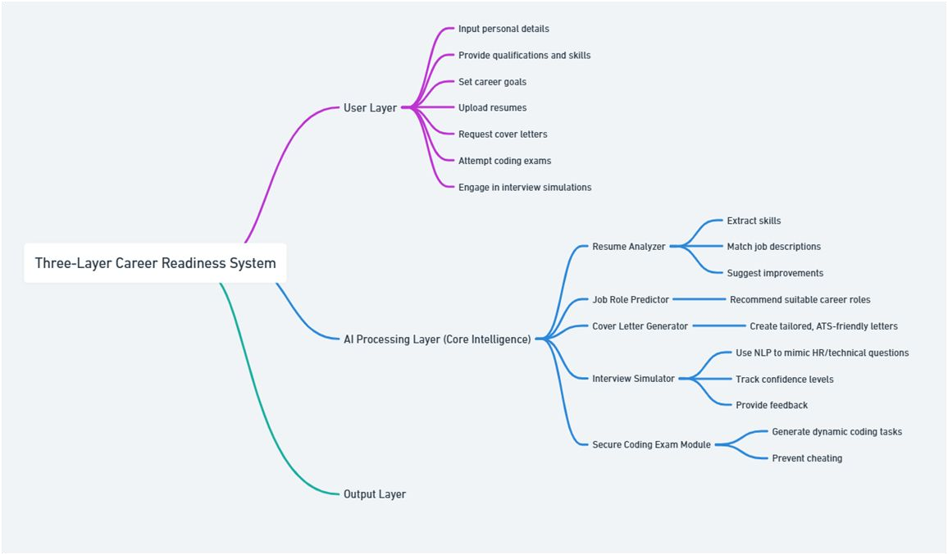
Project Design
e
f
Fit.1 System Architecture of Career Companion

Slide 12
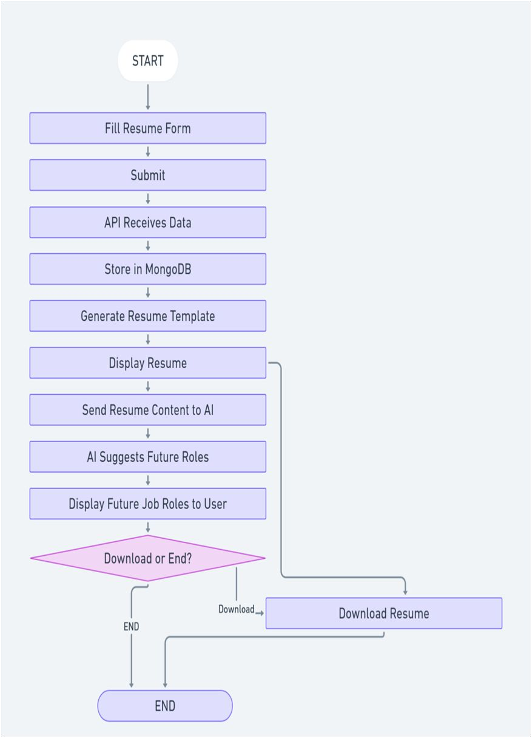
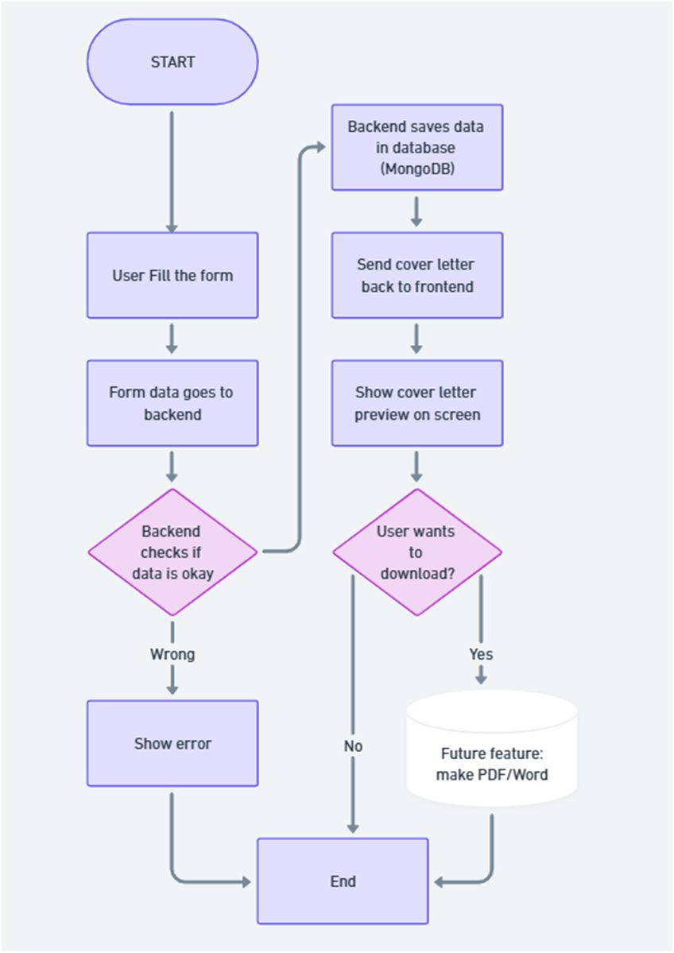
Project Design (cont…)
Fig.2 FlowChart of Resume Generator with job prediction
Fig.3 FlowChart of Cover Letter generator

Slide 13
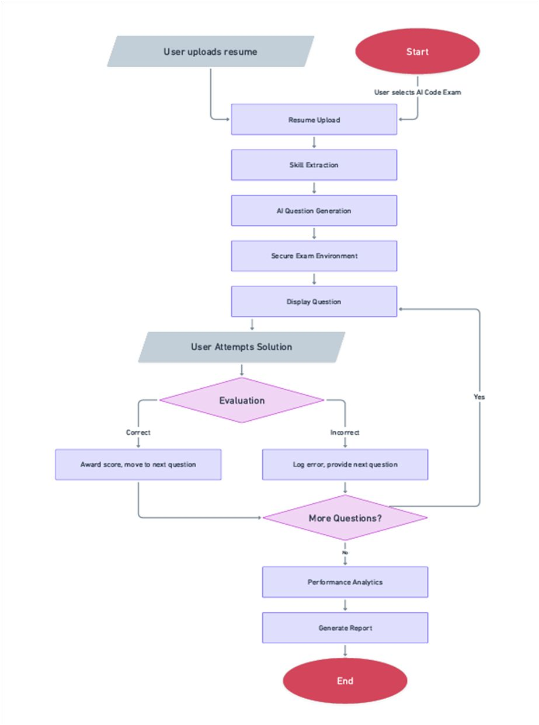
Project Design (cont…)
Fig.4 FlowChart of interview training module

Slide 14
Tools, Technologies and Languages
Frontend Development
React.js – Component-based, responsive UI
Tailwind CSS – Utility-first CSS for fast styling
Chart.js / D3.js – Interactive graphs and analytics
Backend Development
Node.js + Express.js – API handling, server-side logic
REST APIs & WebSockets – Real-time communication for coding exams & interview simulations
Databases
MongoDB – NoSQL, flexible resume + user data storage
MySQL – Relational storage for structured exam/interview records

Slide 15
Tools, Technologies and Languages (cont…)
Natural Language Processing (NLP)
Transformer-based LLMs (OpenAI GPT, LLaMA, Falcon, etc.) – Resume parsing, generation, interview Q&A
Hugging Face Transformers – Fine-tuned models for text classification, job-role prediction
cover
letter
Machine Learning
Scikit-learn – Feature extraction, recommendation algorithms
TensorFlow / PyTorch – Model training, evaluation, embeddings
LangChain – Orchestration of LLM pipelines for career tasks
Code Evaluation & Security
Python-based Auto-graders – Test case execution, efficiency check
Plagiarism Detection Models – Compare code submissions for originality
Secure Code Editor – Sandbox execution with anti-cheating mechanisms

Slide 16
Tools, Technologies and Languages (cont…)
Cloud & Hosting
AWS / Azure / GCP – Hosting backend, ML models, and databases
Docker & Kubernetes – Containerization and scaling
Development Tools
Git + GitHub – Version control and collaboration
VS Code / Jupyter Notebooks – Development + ML experimentation
Visualization & Analytics
Matplotlib / Seaborn – Graphs for coding exam performance
Programming Languages
JavaScript (React, Node.js) – Frontend & backend
Python – AI/ML, NLP, evaluation models

Slide 17
Dataset
1. Resume & Job Role Prediction:
Dataset: Resume Dataset (Kaggle)
Available :
– contains resumes labeled with job categories and skills.
https://resumeworded.com/resume-templates
https://www.kaggle.com/datasets/snehaanbhawal/resume-dataset
Usage: Train NLP models to extract skills and predict suitable future jobs.
1. Cover Letter Generator:
Dataset: Job
Descriptions + Sample Cover Letters (open-source collections, online repositories).
Available : https://huggingface.co/datasets/ShashiVish/cover-letter-dataset
Usage: Fine-tune LLMs to generate ATS-friendly, role-specific cover letters.

Slide 18
Key Learnings
Technical Skills
NLP & LLMs for resume, cover letter, and interview modules
Secure coding exam design with analytics visualization
Methodologies
AI-driven recommendation & skill prediction
Agile development with GitHub version control
Outcomes
Developed AI-powered career companion platform
Open-source repo & certifications in AI/ML tools

Slide 19
Work Plan till End-Term Evaluation
Frontend Development
Build website structure using React.js + Tailwind CSS.
Design responsive UI for Resume, Cover Letter, Interview, and Coding modules.
Backend & Database Setup
Configure Node.js + Express.js backend.
Set up MongoDB/MySQL databases for storing user data, resumes, and test attempts.
Feature Implementation
Resume & Cover Letter: Input forms + template generation
Resume Generator basic working with future job role prediction
Integration & Testing
Link frontend and backend modules.
Ensure smooth user flow across all website sections.
Internal testing for usability and bug fixes.

Slide 20
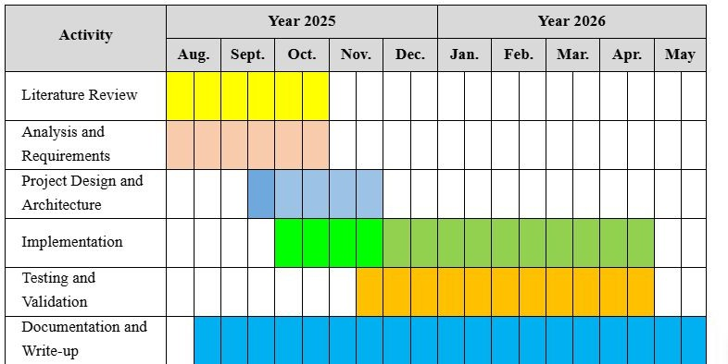
Project Plan

Slide 21
Work Contribution and Attendance
 | Roll No. | Work Done | Work Contribution (%) | Lines of | Lab Attendance
 |  | (provide complete details) |  | Code | (%)
 |  |  |  | (if any)
1. | 221030169 | Researched 5 papers on AI in career guidance and resume parsing. Worked on Resume Generator logic and AI-based job role prediction. Assisted in Cover Letter Generator setup. Prepared PPT slides for AI modules. Prepared Report for mid Evaluation | 25 |  | 100
2. | 221030359 | Researched 5 papers based on project Set up MongoDB backend and connected it with frontend Assisted in integrating Resume & Cover Letter Generator with backend Prepared PPT slides for cloud/backend section | 25 |  | 100
3. | 221030199 | Researched 5 papers on NLP for resumes Assisted in implementing AI job suggestions in Resume Generator Contributed to flowcharts and system diagrams for mid-term Prepared PPT slides for AI/ML sections | 25 |  | 100
4. | 221030420 | Researched 5 papers based on project Worked on website frontend and cloud integration Assisted in connecting Resume & Cover Letter Generator with database Prepared PPT slides for website & deployment demo Prepared Report for mid Eval. | 25 |  | 100
GitHub Repository URL: https://github.com/221030169/AI-Powered-Career-Growth-and-Productivity-Platform-
Team M2431. ember
Major Project – I (18B19CI791) Mid-Term Evaluation | Department of CSE & IT | AY 2025-26. _{21.}

Slide 22
Supervisor Interactions (as mentioned in weekly log)
No. of Meetings with Supervisor: 11
Week No. | Duration | Remarks (as mentioned in the weekly log) | Incorporated (Yes/No)
1. | 18/08/2025 to 23/08/2025 | Decide on the project title. Refine the proposal. Submit the proposal | Yes
2. | 01/09/2025 to 06/09/2025 | Create a workflow diagram Divide project in various models. | Yes
3. | 15/09/2025 to 20/09/2025 | Create a github repo. Work on the roadmap discussed 4 Flow charts, 1 DFD Maintain Github Repo Read Research Paper approx 20 | Yes
4. | 22/09/2025 to 27/09/2025 | Reading research paper completed. | Yes

Slide 23
References
T. T. H. Nguyen, et al., "SimInterview: Transforming Business Education through LLM-Based Simulated Multilingual Interview Training System," arXiv preprint arXiv:2508.11873, 2025. [Online]. Available: https://arxiv.org/abs/2508.11873v1
H. Koshti, et al., "AI-Powered Interview Preparation System: Integrating Resume Analysis, HR Simulation, and Technical Skill Assessment," Journal of Engineering Research and Reports (JERR), 2025. [Online]. Available: https://journaljerr.com/index.php/JERR/article/view/1489
M. Gayathri Devi, et al., "AI Friendly Resume," International Journal of Scientific Research in Engineering and Management (IJSREM), 2024. [Online]. Available: https://ijsrem.com/download/ai-friendly-resume/
N. A. Kadam, N. P. Pawar, N. R. Pandit, None A. Phalke, and None S. Jagadale, "AI Powered Recruitment System," Deleted Journal, vol. 3, no. 07, pp. 3203–3208, Jul. 2025. [Online]. Available: https://irjaeh.com/index.php/journal/article/view/994
S. Divya and V. Manaswini, "Personalized Career Recommendation System Using Machine Learning," International Research Journal of Modernization in Engineering Technology & Science, vol. 07, no. 07, pp. 1–10, Jul. 2025. [Online]. Available: https://www.irjmets.com/upload_newfiles/irjmets70700103353/paper_file/irjmets70700103353.pdf
T. A. Bloch and I. Inusa, "GPT-3-Based AI Cover Letter Generator: A Feasibility Study & Implementation," 5th International Conference on Recent Trends in Machine Learning, IoT, Smart Cities, and Applications, Lecture Notes in Networks and Systems, Springer, 2025. [Online]. Available: https://www.researchgate.net/publication/389461890_GPT-3-Based_AI_Cover_Letter_Generator_A_Feasibility_Study_Implementation

Slide 24
References (cont…)
A. S. Abishek, C. St Hubert, D. S. Dhanvarshan, and D. S. Kumar, "Automated Code Review and Feedback using Machine Learning," International Journal of Novel Research and Development, vol. 10, no. 1, Jan. 2025. [Online]. Available: https://www.ijnrd.org/papers/IJNRD2501308.pdf
S. Pede, P. Kolekar, A. Metkar, and A. Joshi, "Resume Parsing and Skill Extraction using Custom Pattern Matching Algorithm and Gemini API," 8th International Conference on Computing, Communication, Control and Automation (ICCUBEA), Aug. 2024. [Online]. Available: https://www.researchgate.net/publication/387922476_Resume_Parsing_and_Skill_Extraction_using_Custom_Pattern_Matching_algorithm_and_Ge mini_API
B. Sahu, S. Marju, A. Shikalgar, and D. Rupnashwar, "AI-Powered Resume Screening: Enhancing Efficiency and Fairness," 2025. [Online].
Available: https://ijnrd.org/viewpaperforall.php?paper=IJNRD2506063
C. Yadav, R. Dhakad, Afroj, M. Panchal, and E. B. Kaur, "Revolutionizing Nearby Accommodation: An in-depth Analysis of React.js, Node.js, MongoDB, and Express.js Integration for Website Development," International Conference on Innovative Computing & Communication (ICICC), 2024. [Online]. Available: https://papers.ssrn.com/sol3/papers.cfm?abstract_id=4932790
V. Sahni, A. Chopde, M. Goswami, and A. Kumar, "MERN (MongoDB, Express.js, React.js, Node.js) Stack Web-Based Themefied Education Platform for Placement Preparation," Educational Administration Theory and Practice Journal, vol. 30, no. 5, May 2024.
C. Yadav, R. Dhakad, Afroj, M. Panchal, and E. B. Kaur, "Revolutionizing Near-by Accommodation: An in-depth Analysis of React.js, Node.js, MongoDB, and Express.js Integration for Website Development," Proceedings of the International Conference on Innovative Computing & Communication (ICICC), Aug. 2024.
C. Sravani, "Constructing a Study Buddy Using MERN (MongoDB, Express.js, React, Node.js) Stack Technologies," Engineering Proceedings, July 2024. doi: 10.3390/engproc2024066027. [Online]. Available: https://doi.org/10.3390/engproc2024066027

Slide 25
References (cont…)
C. G. Onukwugha, C. Ofoegbu, O. B. Aliche, and C. U. Betrand, "Resume Optimization Model Using Machine Learning Techniques," International Journal of Intelligent Information Systems, vol. 13, no. 5, pp. 109–116, Oct. 2024. doi: 10.11648/j.ijiis.20241305.12. [Online]. Available: https://doi.org/10.11648/j.ijiis.20241305.12
C. Li, et al., "Competence-Level Prediction and Resume & Job Description Matching Using Transformer Models," arXiv preprint arXiv:2006.XXXX, 2020.
R. Patil, et al., "Automated Assessment of Multimodal Answer Sheets in the STEM Domain," Papers With Code, 2024.
M. S. Khan, et al., "Automated Assessment for C/C++ Programming in ODL Environment," Papers With Code, 2022.
P. Sharma and R. Singh, "Personalized Job Search with AI: Skill-Based Matching," IJERT, 2023.
"Personalized Career Roadmap Generation," International Journal of Novel Research and Development (IJNRD), vol. 10, Issue 4,
April 2025, ISSN: 2456-4184. [Online]. Available: https://www.ijnrd.org/papers/IJNRD2504150.pdf
S. J. Russell and P. Norvig, "Search in Complex Environments," in Artificial Intelligence: A Modern Approach, 4th ed. Upper Saddle River, NJ, USA: Pearson, 2020, ch. 4, pp. 127–180.
I. Goodfellow, Y. Bengio, and A. Courville, "Optimization for Training Deep Models," in Deep Learning. Cambridge, MA, USA: MIT Press, 2016, ch. 8, pp. 271–322.
OpenAI, "GPT-4 Technical Report," Mar. 2023. [Online]. Available: https://arxiv.org/abs/2303.08774

Slide 26
References (cont…)
Wikipedia, “Retrieval-augmented generation (RAG) ”. Available: en.wikipedia.org/wiki/Retrieval-augmented_generation
D. Pandey, "AI-Powered Recruitment: Transforming Talent Acquisition in the Digital Age," Journal of Artificial Intelligence and Emerging Technologies, vol. 5, no. 1, p. 1742, Feb. 2025.

Slide 27

Thanks.

